Slide 1
Multiplication Tables Check. Information for parents
F.Edwards
22nd January 2019

Slide 2
What is the Year 4 times table check?

Slide 3
Who will take the MTC?
All eligible year 4 pupils who are registered at maintained schools, special schools or academies in England.
It is possible to withdraw certain children from the assessment. Full details will be published in Oct 2019. However, we expect the grounds for withdrawal to be stricter than grounds for withdrawing from the SAT's tests.

Slide 4
The MTC will be statutory for children currently in year 3 and below.
However, at Abbeywood we have decided to take part in the 2019 voluntary check in June 2019. This will take place between 10-28 June 2019. This will allow us see the format of the test and the accessibility of the test.
It is really important that children from year 2 onwards develop fluency in their multiplication facts this year. By the end of year 3 children should be fluent in the 2,3,4,5,8 and 10 times tables.

Slide 5
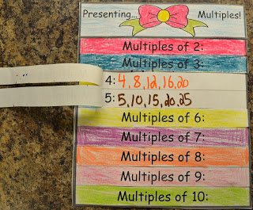
The times table check The check will take place is online and on-screen in June each year
The test will be fully digital and take place on screen. It will be available to use on laptops, desktops and tablets.
There will be a 3 week window in June for the administration of the check.
There is no set test day, nor an expectation that all children will take the test at the same time.
This Photo by Unknown author is licensed under CC BY-NC-ND.

Slide 6
Key information
The check will take less than 5 minutes per pupil.
Children will have 6 seconds to answer each question.
Children can practise before taking the check.
The facts must be read by the child.
Children will face 25 questions.
Whatever is in the box at the end of the 6 seconds will be counted as the answer.
8 x 9 = 7

Slide 7
Key Information
The questions will be randomly assigned.
The check has been designed to focus on times tables that fit within the KS2 curriculum.
The 6,7,8,9 and 12 times tables are more likely to be asked than the 2,3,4,5,10 or 11 multiplication tables.
There will always be questions from the 3,4,5,6,7,8,9,11 and 12 multiplication tables in each test.
There will be no questions from the 1 times table, (1 x 8 or 8 x 1)

Slide 8
Multiplication table limits in the MTC

Slide 9
8 x 3 is 8 three times
The Standards and Testing Agency state that they are classifying the multiplication tables by the first number in the question. For example, 8 x 3 would fall within the 8 times table.
This reflects what is now considered best practice and how we teach multiplication tables at Abbeywood- 8 x 3 should be thought of as 8, three times rather than 8 lots of 3.

Slide 10
Commutativity is Really Important
It is important that children understand the commutative property of multiplication and that 6 x 3 (6 three times) has the same value as 3 x 6 (3 six times)

Slide 11
The Results
Results will only be available after the 3-week window.
There is no pass rate or threshold.

Slide 12
How we are helping your child to be ready
5 hits of maths per day.
Visualisation
Play with the array
Number Fun Monster
Number fun songs
Counting games
Challenges
Tables tricks and tips
Rote learning
Games
ICT
Embedding tables, reasoning.

Slide 13
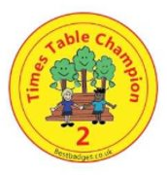
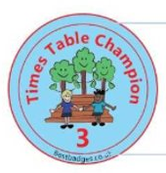
Milestone Expectations
Milestone 1: 10 x, 2x and 5 x
Milestone 2 : 3x, 4x and 8x
Milestone 3: 6 x, 7x, 9x, 11 x and 12 x

Slide 14
How you can help at home
Learning the times tables takes time, dedication and patience. Introducing them in a fun and interactive way is by far the best way to start.
Encourage your child to learn their times tables by being as involved as possible and checking their progress often.
Little tips and tricks can make a huge difference in instilling the times tables into their memories and help build their confidence.

Slide 15
Mathletics
Encourage your child to complete their mathletics activities set by teachers and take part in live games and play some fun games too.
This Photo by Unknown author is licensed under CC BY-SA.

